Slide 1
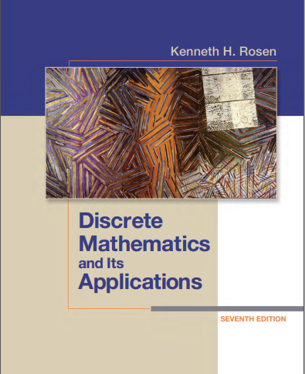

Discrete structures
By Dr. sajid iqbal
Course Reference Book

Slide 2
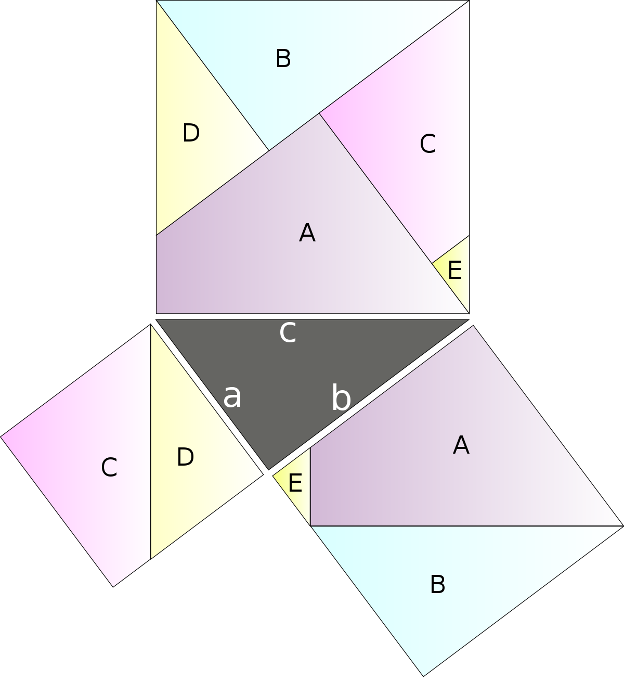
The foundations: logics and proofs
Chapter - 1

Slide 3

Introduction
Logic rules specify the meaning of mathematical statements
Logic is base of mathematical and automated reasoning
Design of computing machines require well defined logic rules
To understand mathematics, we must understand proofs which make up a correct mathematical argument
Once we prove a mathematical statement is true, we call it a theorem
A collection of related theorems makes a mathematical topic
Proofs are very important in computer science
proofs are used to verify that computer programs produce the correct output for all possible input values
Automated reasoning systems have been created to allow computers to construct their own proofs
Theorem Proving
Statements | Arguments
… | …
$$S_{n}=\frac{n}{2}\left[2a+\left(n−1\right)d\right]$$
Sum of an arithmetic series
This chapter deals with correct mathematical
arguments and how to construct them

Slide 4
Propositional logic
The rules of logic give precise meaning to mathematical statements
These rules are used to distinguish between valid and invalid mathematical arguments
Logic rules have numerous applications to computer science. These can be used in
Construction of computer programs
Development of hardware circuits
Verification and validation of developed programs

Slide 5
Propositional logic
Propositions
A proposition is a declarative sentence that is either true or false but not both at same time
Examples: Propositions
The sun rises from east → True
Islamabad is capital of Pakistan → True
You are student of BSCS class → True
1+1=3 → false
2+3=10 → false
Examples: Non-Propositions
Who are you?
He is intelligent
Read this carefully

Slide 6

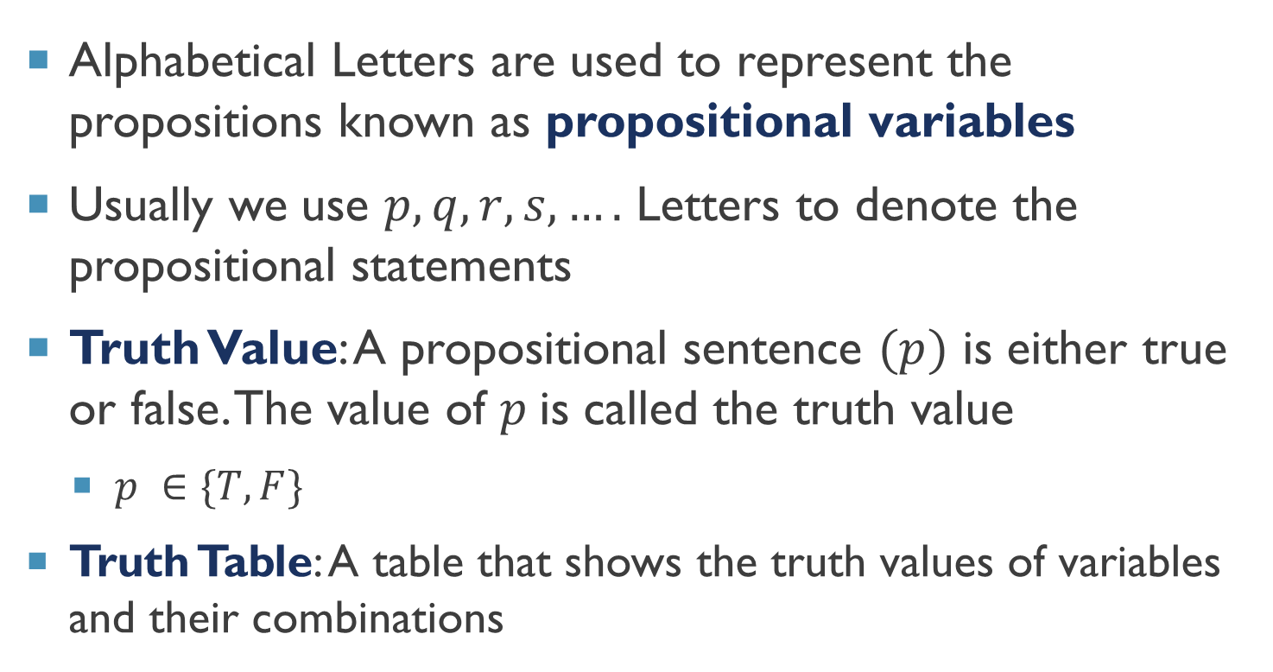
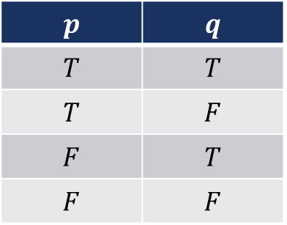
Propositional variables
Alphabetical Letters are used to represent the propositions known as propositional variables
Usually we use $p,q,r,s,….$ Letters to denote the propositional statements
Truth Value: A propositional sentence $(p)$ is either true or false. The value of $p$is called the truth value
$p ∈\{T,F\}$
Truth Table: A table that shows the truth values of variables and their combinations
$$p$$
$$T$$
$$F$$
$$p$$ | $$q$$
$$T$$ | $$T$$
$$T$$ | $$F$$
$$F$$ | $$T$$
$$F$$ | $$F$$

Slide 7
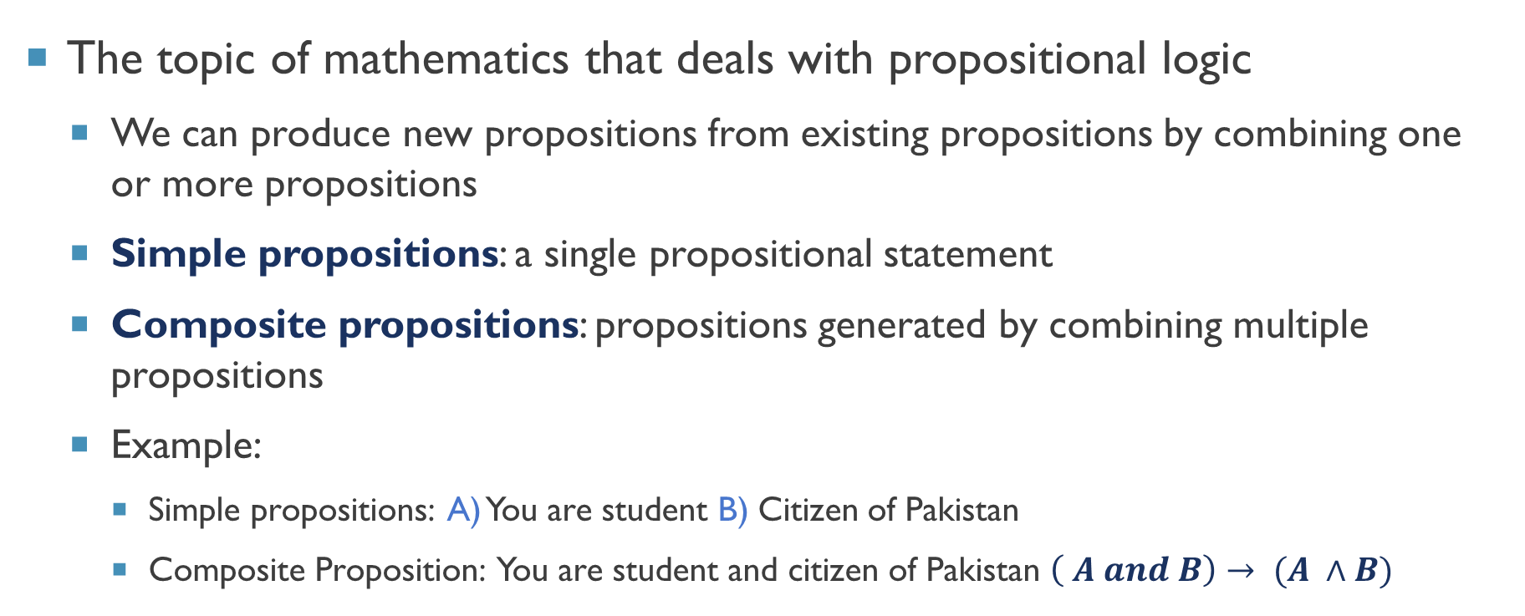
Propositional Calculus
The topic of mathematics that deals with propositional logic
We can produce new propositions from existing propositions by combining one or more propositions
Simple propositions: a single propositional statement
Composite propositions: propositions generated by combining multiple propositions
Example:
Simple propositions: A) You are student B) Citizen of Pakistan
Composite Proposition: You are student and citizen of Pakistan $\left( A and B\right)→ (A ∧B)$

Slide 8
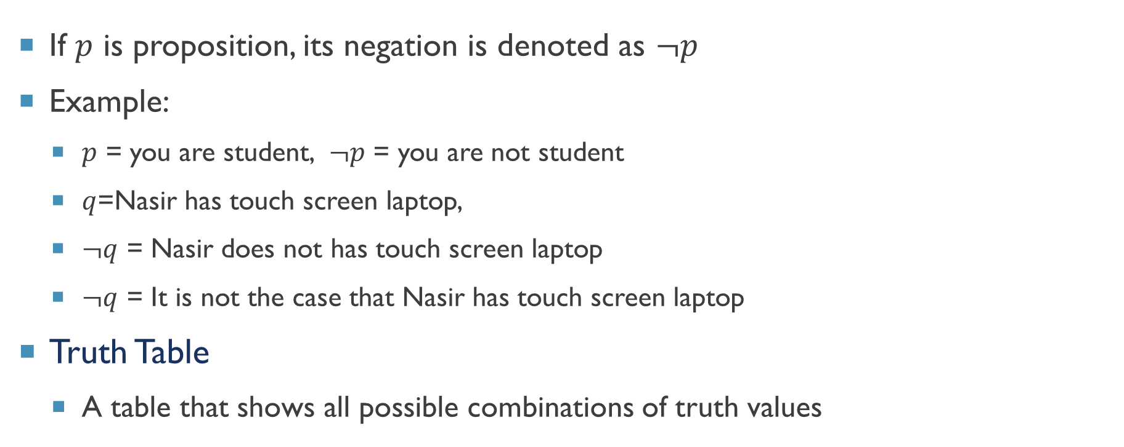

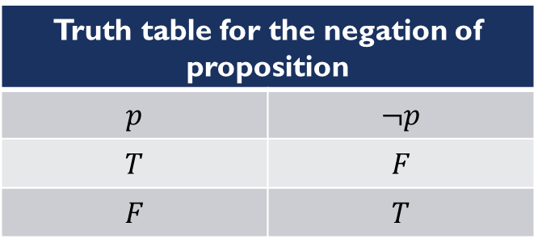
Negation of Proposition ($¬$)
If $p$ is proposition, its negation is denoted as $¬p$
Example:
$p$ = you are student, $¬p$ = you are not student
$q$=Nasir has touch screen laptop,
$¬q$ = Nasir does not has touch screen laptop
$¬q$ = It is not the case that Nasir has touch screen laptop
Truth Table
A table that shows all possible combinations of truth values
Truth table for the negation of proposition
$$p$$ | $$¬p$$
$$T$$ | $$F$$
$$F$$ | $$T$$

Slide 9



Thanks for watching
Dr. Sajid Iqbal
Assistant Professor
Department of Computer Science
Bahauddin Zakariya University, Multan
sajidiqbal.pk@gmail.com
https://github.com/sajjo79/DiscreteMathematics
Allah Hafiz
COMEDXD

